Slide 1
Graphs for paper
1st May 2023

Slide 2
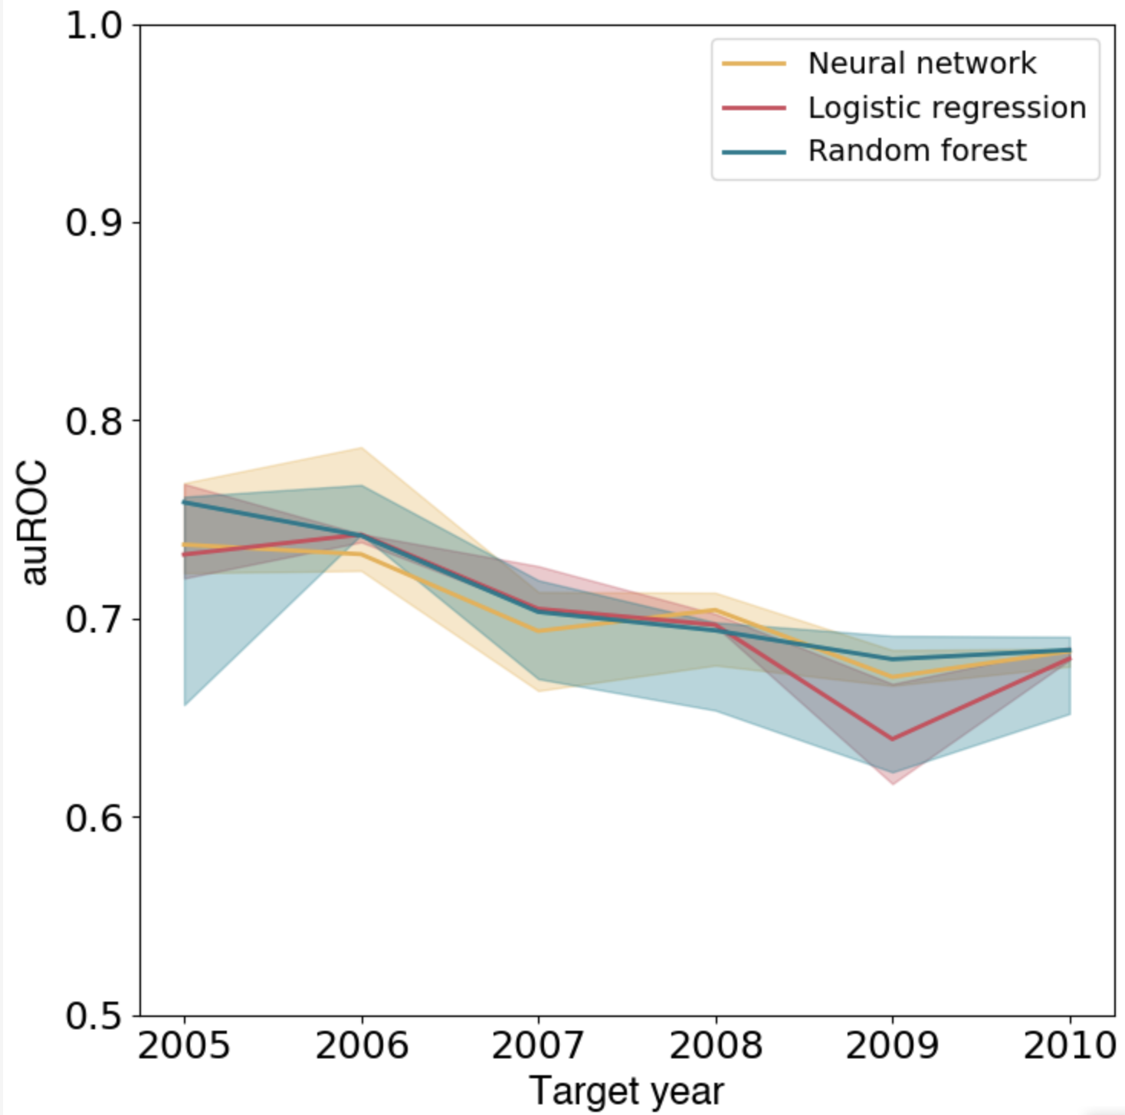
auROC + 95% CI shaded

Slide 3
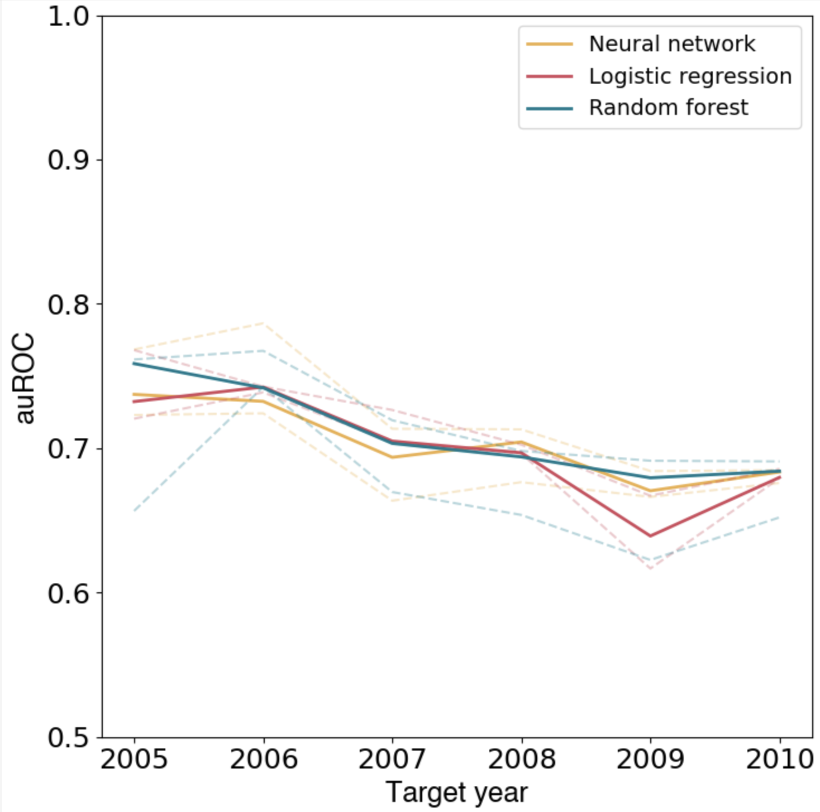
auROC + 95% CI lines

Slide 4
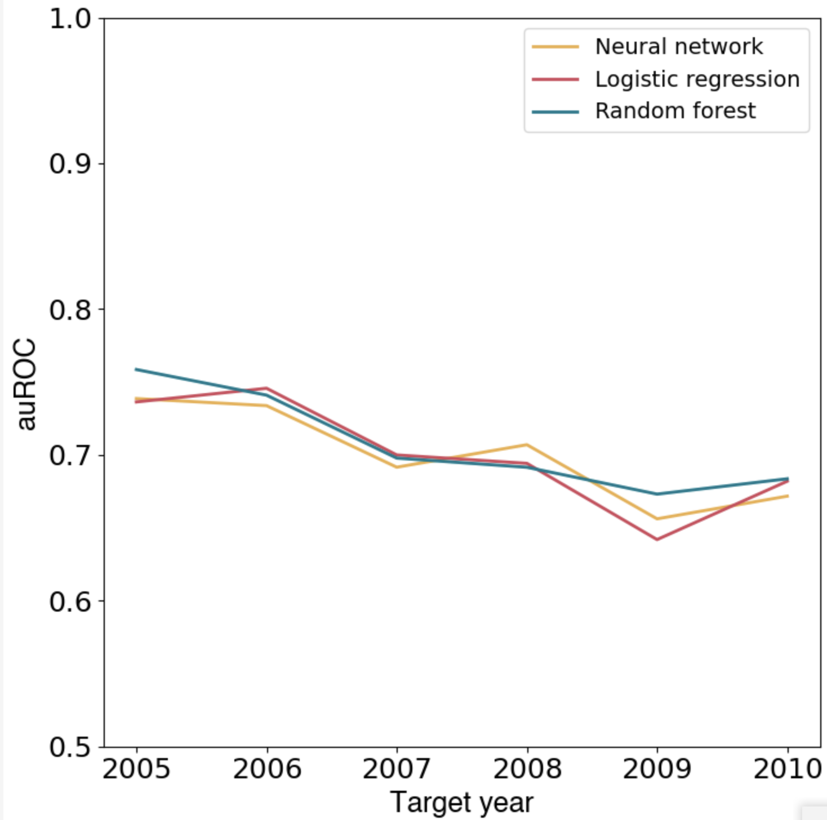
Optimism-corrected auROC

Slide 5
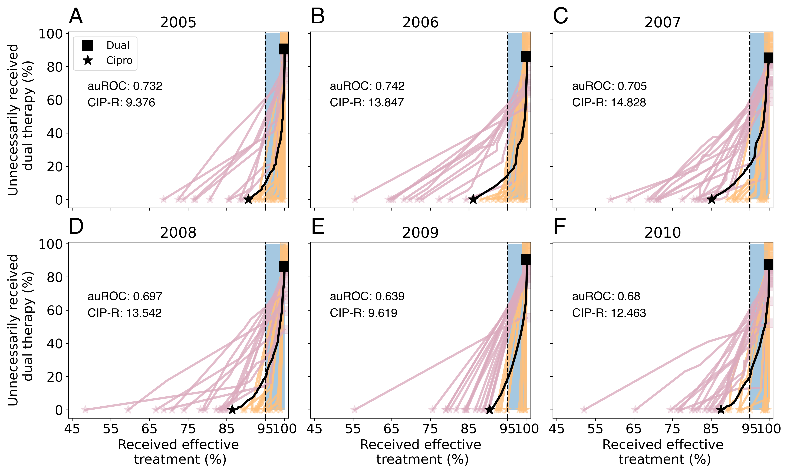
Baseline LOOCV (for LR)
The clinics whose CIP-R were higher than the average typically also had higher proportions of cases amongst the MSM community.

Slide 6
Why does it perform worse on some clinics?
The clinics whose CIP-R were higher than the average typically also had higher proportions of cases amongst the MSM community.
Adding in prevalence of MSM didn’t do much
Could be an artefact of plotting - for so many of the orange lines, they almost “have” to lie close to the black line as they are near 100% effective treatment anyway.
No difference in average number of observations

Slide 7
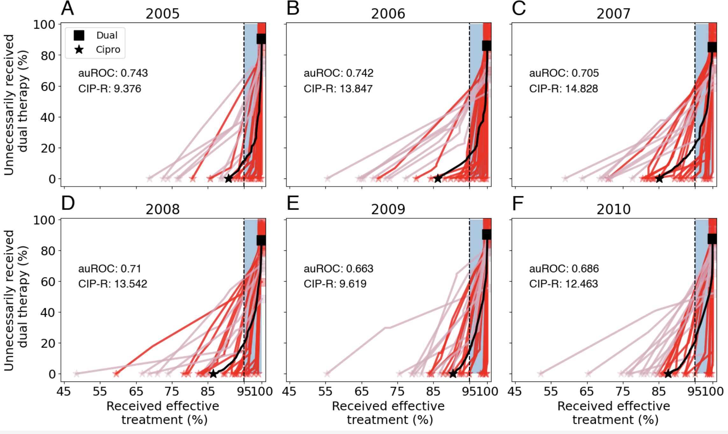
LOOCV + coloured by < 25% cases in MSM

Slide 8
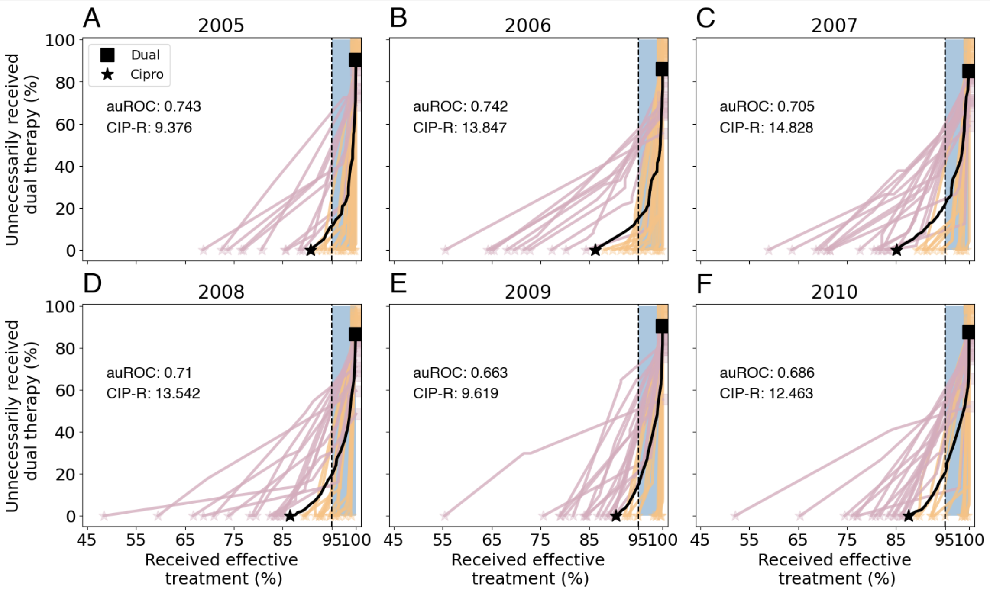
LOOCV + % cases in MSM + change in % MSM
No real change, and no real change in auROC

Slide 9
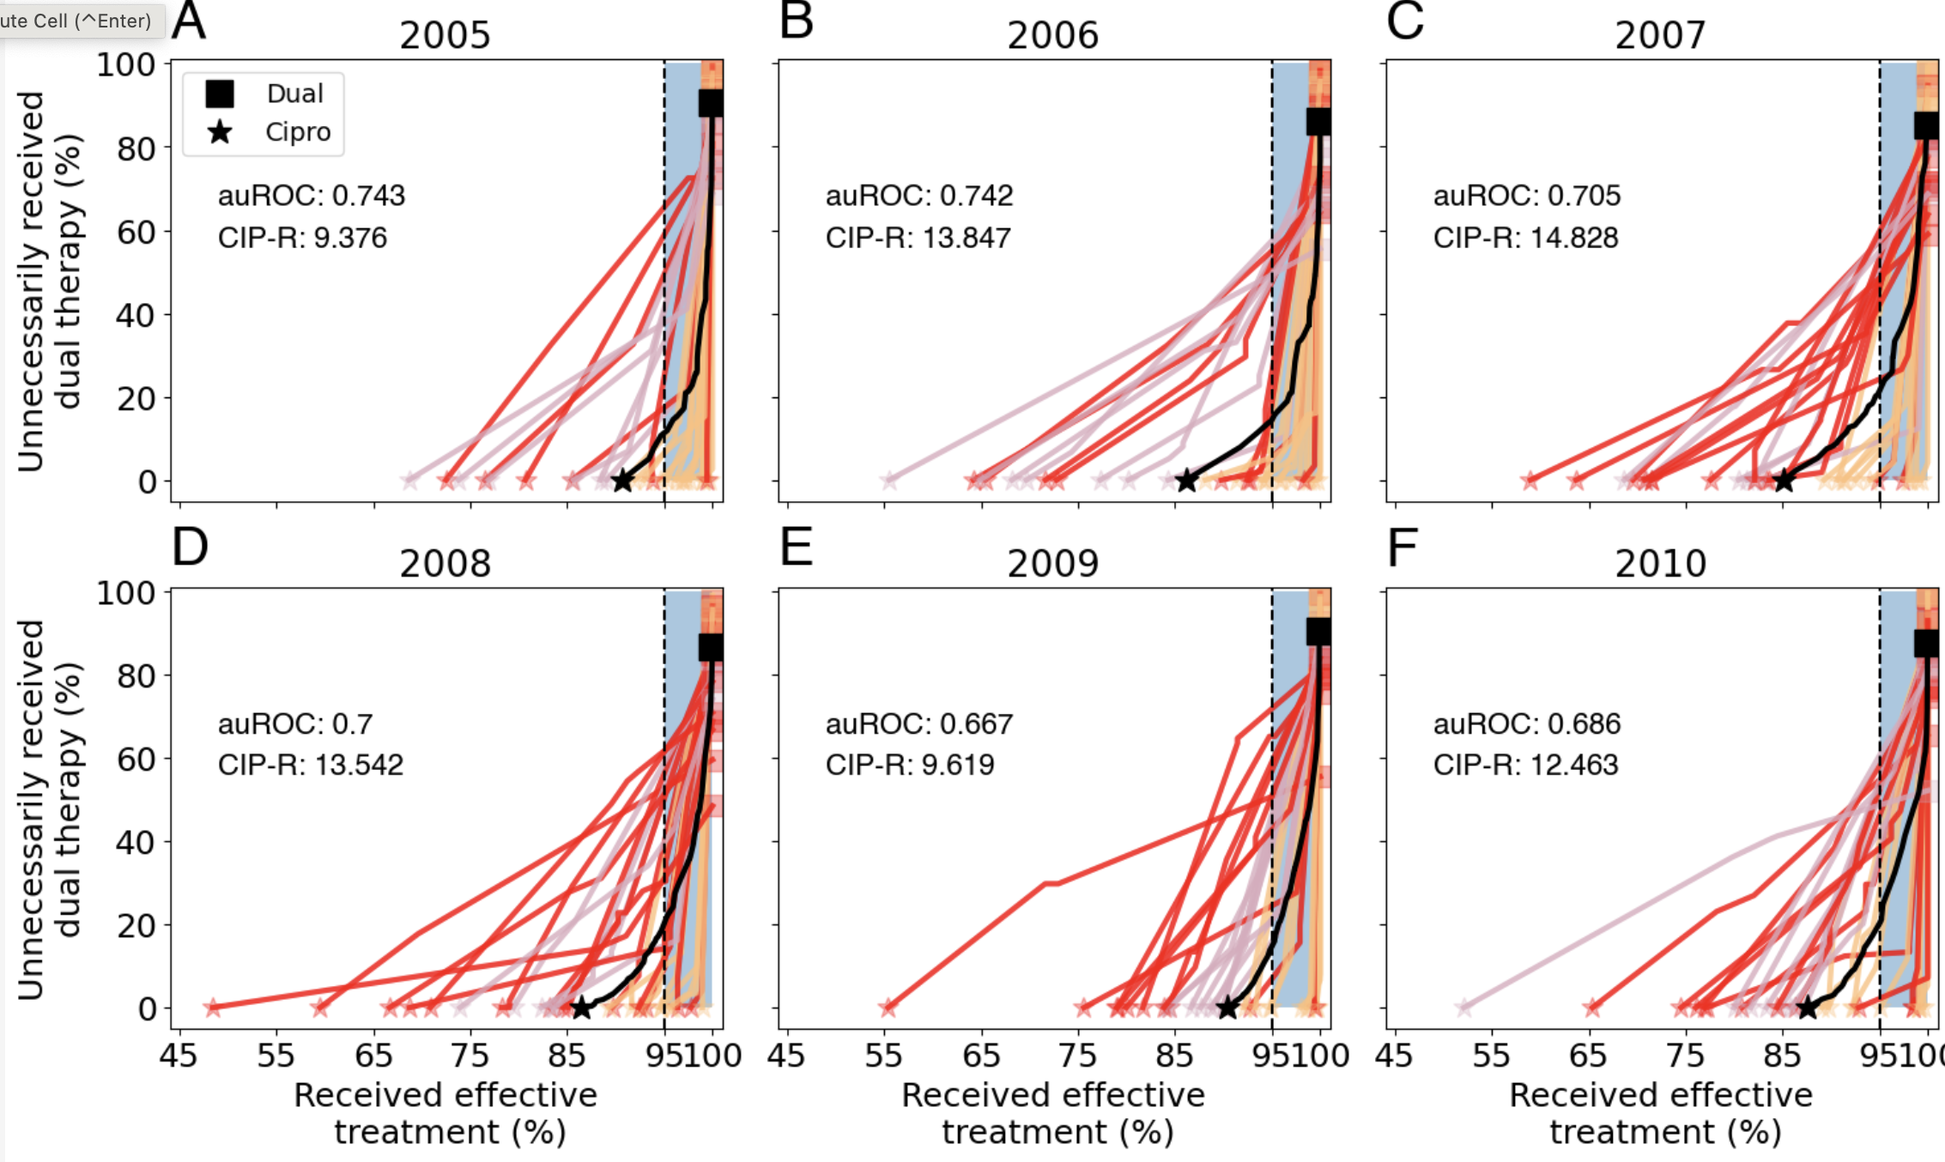
LOOCV + coloured by < 200 observations (average is 200 – 238 per year)
Later years – where predictions are
worse – more of the high-prevalance
clinics have worse predictions

Slide 10
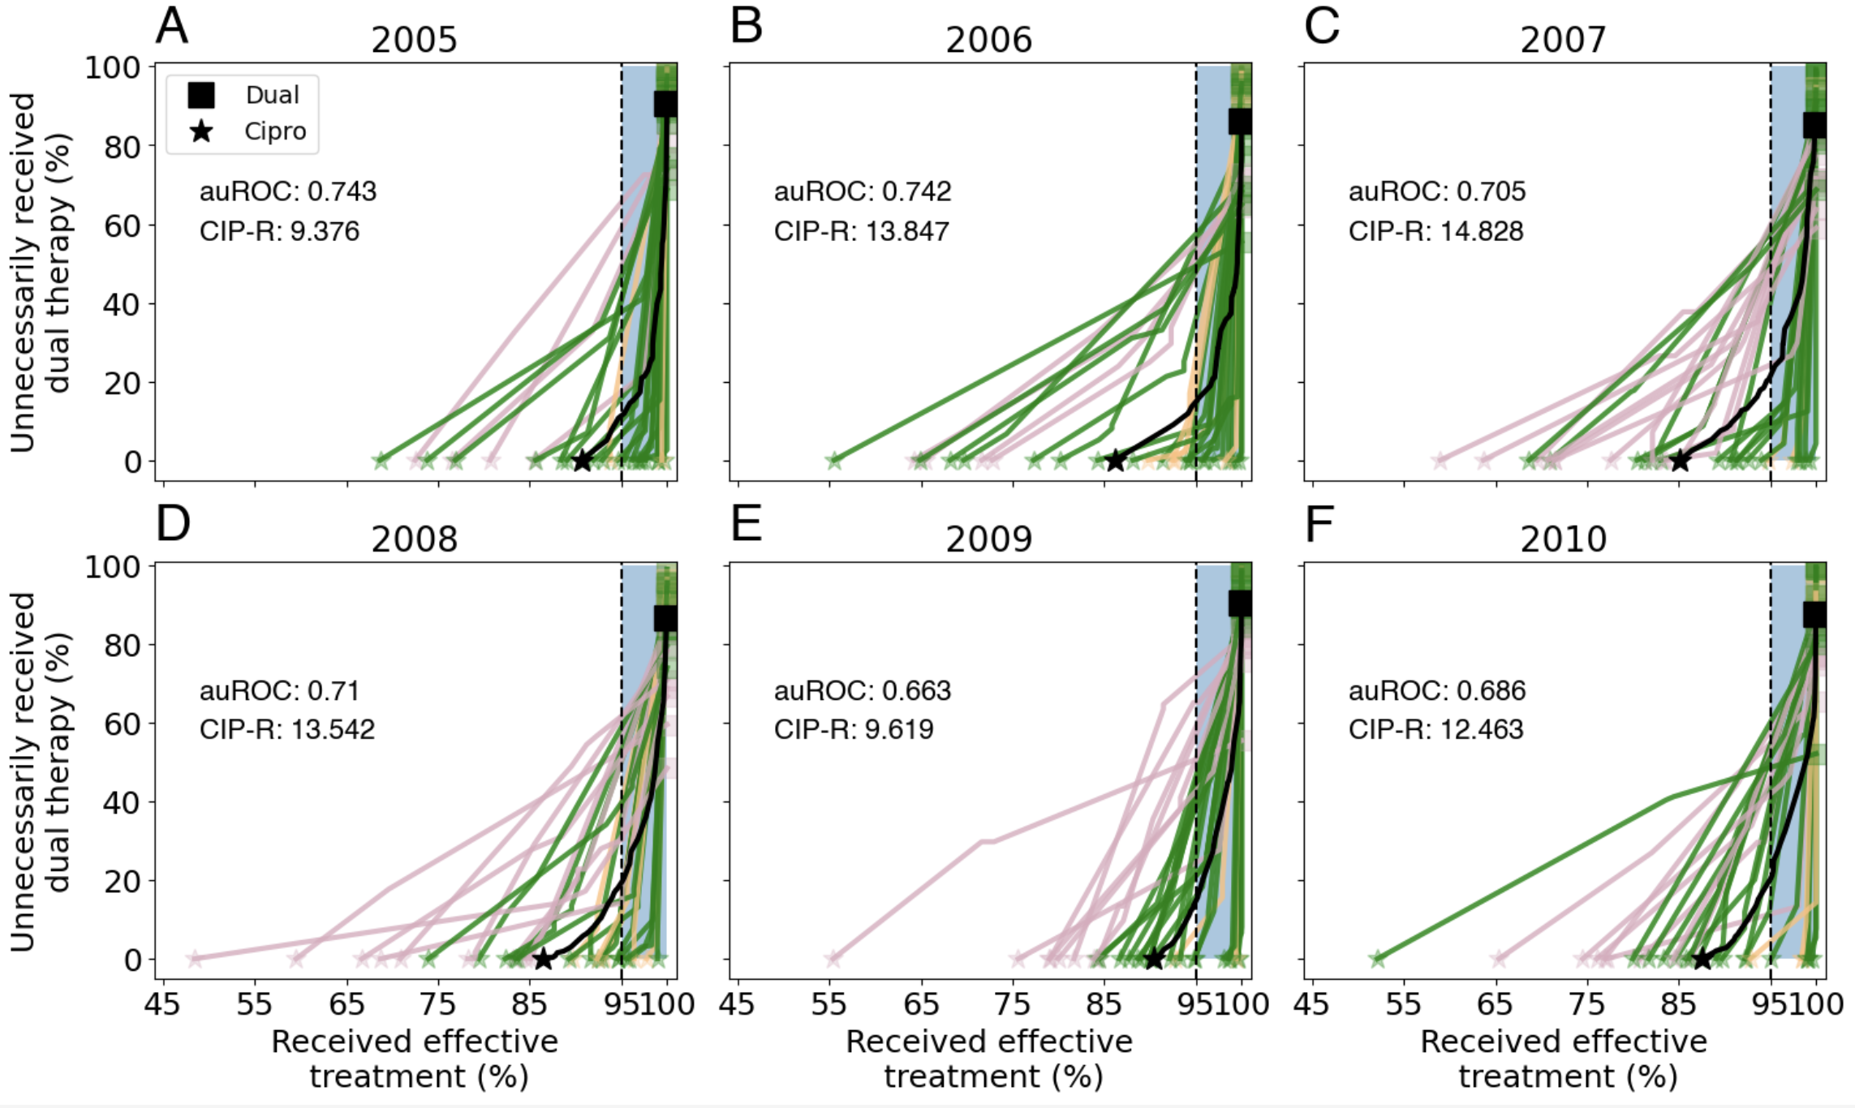
LOOCV + coloured by > 200 observations (average is 200 – 238 per year)

